Slide 1
Branching

Slide 2
References
BH chapter 3
KI 6.3, 6.4 , 6.5

Slide 3
Branching
CPU executes program sequentially
However control can be transferred to other parts.
Transfers can be conditional or unconditional
Conditional Transfers:
Control is transferred to a new location if a certain condition is true
Unconditional Transfers:
Control is transferred to a new location in all cases.
The program will start running sequentially from where the control was transferred.

Slide 4
Branching in HLL
Following is an example of conditional transfer in C++
If (x!=0)
{
Z=Y/X
}
while (c<10)
{
sum= a[c--]
}
goto in C++ can be used for unconditional jump

Slide 5
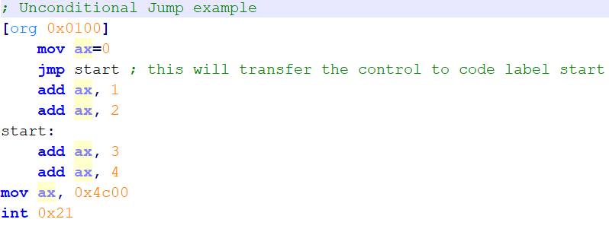
Unconditional Jump in Assembly
JMP is used for unconditional jump to another part of code
Format
JMP <destination>
Where destination can be any 16 bit address where your desired instruction is located.
Usually it’s a code label
Example:
Notes:
; Unconditional Jump example
[org 0x0100]
mov ax,0
jmp start ; this will transfer the control to code label start
add ax, 1
add ax, 2
start:
add ax, 3
add ax, 4
mov ax, 0x4c00
int 0x21

Slide 6
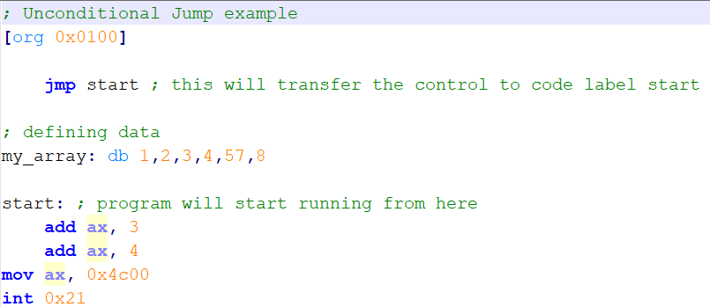
Unconditional Jump in Assembly
Especially used when data is defined within code
Notes:
; Unconditional Jump example
[org 0x0100]
jmp start ; this will transfer the control to code label start
; defining data
my_array: db 1,2,3,4,57,8
start: ; program will start running from here
add ax, 3
add ax, 4
mov ax, 0x4c00
int 0x21

Slide 7
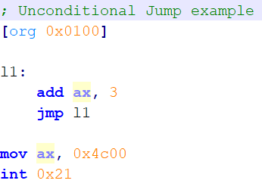
Question:
What is the following code doing?

Slide 8
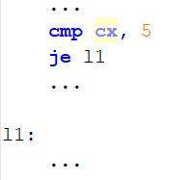
Conditional Jumps
Conditional jump and LLL are implemented a combination of comparisons and jumps.
It’s a two step process:
First, an operation such as CMP, AND, or SUB modifies the CPU status flags.
Second, a conditional jump instruction tests the flags and causes a branch to a new address.
Example of code snippet

Slide 9
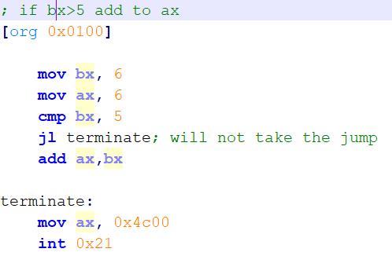
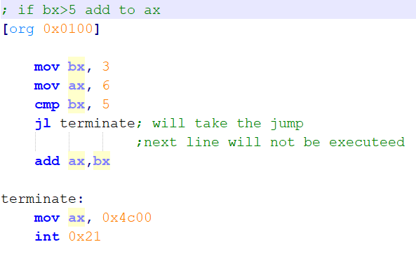
Example
Notes:
; if bx>5 add to ax
[org 0x0100]
mov bx, 3
mov ax, 6
cmp bx, 5
jl terminate; will take the jump
;next line will not be executeed
add ax,bx
terminate:
mov ax, 0x4c00
int 0x21

Slide 10
Cmp instrution
The CMP (compare) instruction performs an implied subtraction of a source operand from a destination operand.
Neither operand is modified
The CMP instruction changes the Overflow, Sign, Zero, Carry, Auxiliary Carry, and Parity flags according to the value the destination operand would have had if actual subtraction had taken place.

Slide 11
Conditional jump instruction
In last examples you saw je and jl instructions.
These are example of conditional jump instructions
Je stands for jump if equal, jl stands for jump if larger.
There are many other conditional jumps.
These instructions uses flags to check whether to take or not take the jump.
For example:
je will check ZF to see if the numbers were equal or not.
cmp would have set ZF to 1 is both operands were equal
Format is
<conditional jump instruction> <destination>

Slide 12
Types of Conditional jumps
Jumps based on specific flag values
Jumps based on equality between operands or the value of CX
Jumps based on comparisons of unsigned operands
Jumps based on comparisons of signed operands

Slide 13
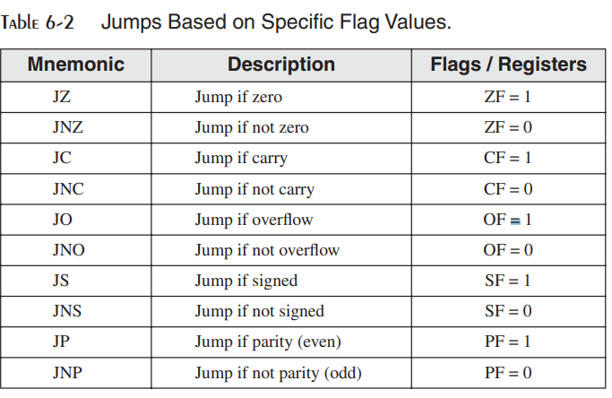
Types of Conditional jumps

Slide 14
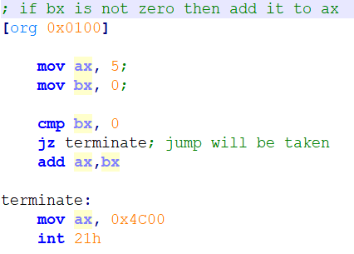
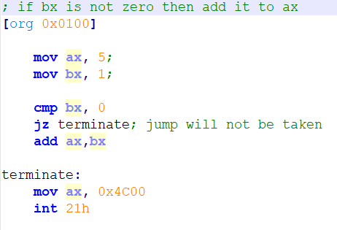
Example
Notes:
; if bx is not zero then add it to ax
[org 0x0100]
mov ax, 5;
mov bx, 1;
cmp bx, 0
jz terminate; jump will not be taken
add ax,bx
terminate:
mov ax, 0x4C00
int 21h

Slide 15
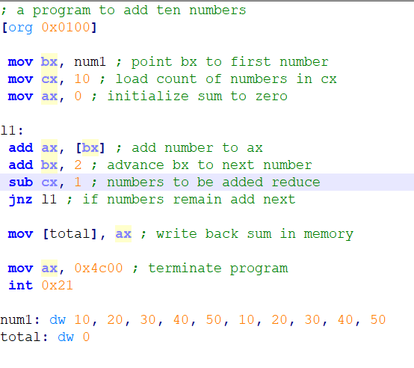
Example
Notes:
Change the code and write it using jcxz, hint jmp
; a program to add ten numbers
[org 0x0100]
mov bx, num1 ; point bx to first number
mov cx, 10 ; load count of numbers in cx
mov ax, 0 ; initialize sum to zero
l1:
add ax, [bx] ; add number to ax
add bx, 2 ; advance bx to next number
sub cx, 1 ; numbers to be added reduce
jnz l1 ; if numbers remain add next
mov [total], ax ; write back sum in memory
mov ax, 0x4c00 ; terminate program
int 0x21
num1: dw 10, 20, 30, 40, 50, 10, 20, 30, 40, 50
total: dw 0

Slide 16
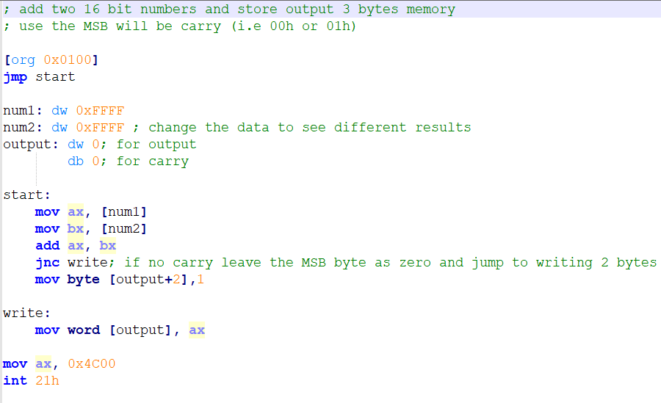
Example
Notes:
; add two 16 bit numbers and store output 3 bytes memory
; use the MSB will be carry (i.e 00h or 01h)
[org 0x0100]
jmp start
num1: dw 0xFFFF
num2: dw 0xFFFF ; change the data to see different
output: dw 0; for output
db 0; for carry
start:
mov ax, [num1]
mov bx, [num2]
add ax, bx
jnc write; if no carry leave the MSB byte as zero and jump to writing 2 bytes
mov byte [output+2],1
write:
mov word [output], ax
mov ax, 0x4C00
int 21h

Slide 17
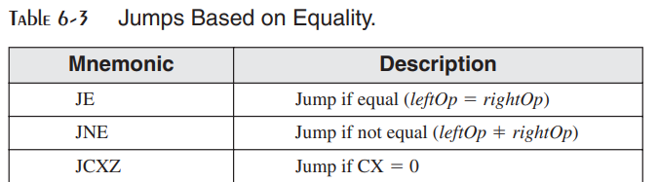
Types of Conditional jumps

Slide 18
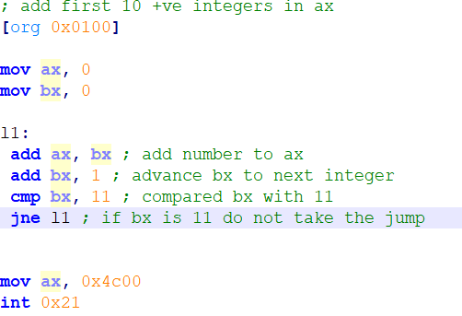
Example
Notes:
; add first 10 +ve integers in ax
[org 0x0100]
mov ax, 0
mov cx, 10
l1:
add ax, bx ; add number to ax
add bx, 1 ; advance bx to next integer
dec cx ; compared bx with 11
jne l1 ; if bx is 11 do not take the jump
mov ax, 0x4c00
int 0x21

Slide 19
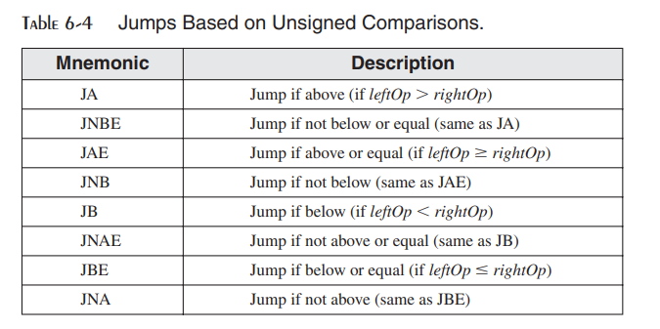
Types of Conditional jumps

Slide 20
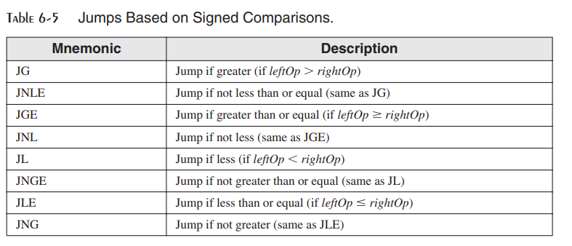
Types of Conditional jumps

Slide 21
Difference Between Signed and Unsigned number
The processor does not consider the difference between signed or unsigned number
It only maintains flags for either case
It depends on programmer how they interpret the flag and which jump instructions they use.

Slide 22
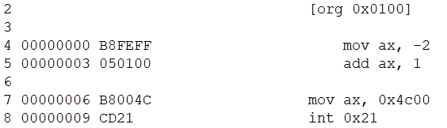
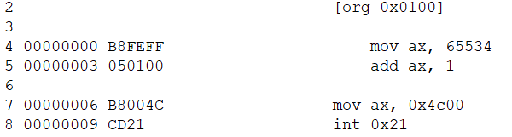
Example
Two different assembly codes
Same machine code
Same ax after code ends
Ax=FFFF
Processor will on SF in both cases
SF=1
It depends on the programmer to interpret AX as 65535 or as -1
Notes:
; add first 10 +ve integers in ax
[org 0x0100]
mov ax, -2
add ax, 1
mov ax, 0x4c00
int 0x21
; add first 10 +ve integers in ax
[org 0x0100]
mov ax, 65534
add ax, 1
mov ax, 0x4c00
int 0x21

Slide 23
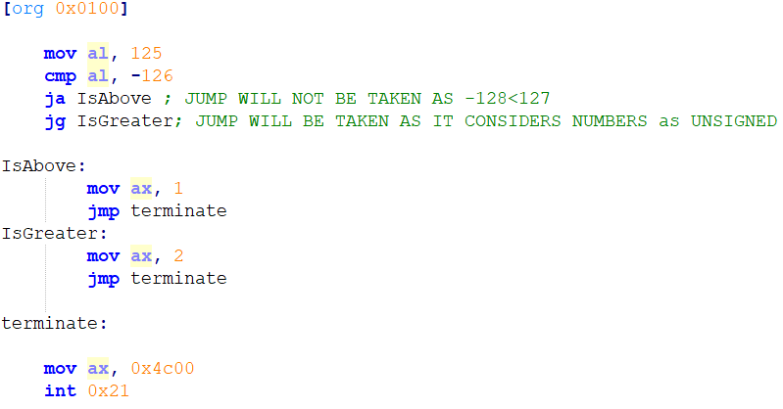
Example
Difference between jumps for signed and unsigned comparison.
After cmp, CF=1, SF=1, OF=1
Notes:
[org 0x0100]
mov al, 7D;125 o
cmp al, 82;can be -126 or 130
ja IsAbove ;
jg IsGreater;
IsAbove:
mov ax, 1
jmp terminate
IsGreater:
mov ax, 2
jmp terminate
terminate:
mov ax, 0x4c00
int 0x21

Slide 24
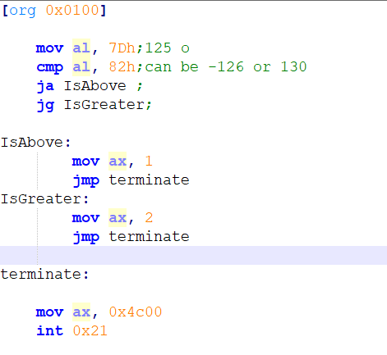
Notes:
[org 0x0100]
mov al, 7Dh;125 o
cmp al, 82h;can be -126 or 130
ja IsAbove ;
jg IsGreater;
IsAbove:
mov ax, 1
jmp terminate
IsGreater:
mov ax, 2
jmp terminate
terminate:
mov ax, 0x4c00
int 0x21

Slide 25
Example
Dec | Hex | Binary
125 | 7D | 0111 1101
-126 | 82 | 1000 0010
125-(-126)= 251 | 7D-82= FB | 1111 1011
CF is on because 7D-82 needs borrow
SF is on because MSB of answer is 1
OF flag is on because, 251 is out of range of -128 to -127
You can also determine OF by looking at the difference in MSB of 1st operand and result (i.e. 7D and FB, they are different)

Slide 26
FLAGs associate with jumps
JB will check CF=1
JL will check SF ≠ OF
JA will check ZF = 0 AND CF = 0
JG will check ZF = 0 AND SF = OF
You can see all these association in table given in BH page 42

